Slide 2
Exiled to Home
Reintegration of Ex-colonials from Ghana
26th July 2018
Bridget Blankley

Slide 3
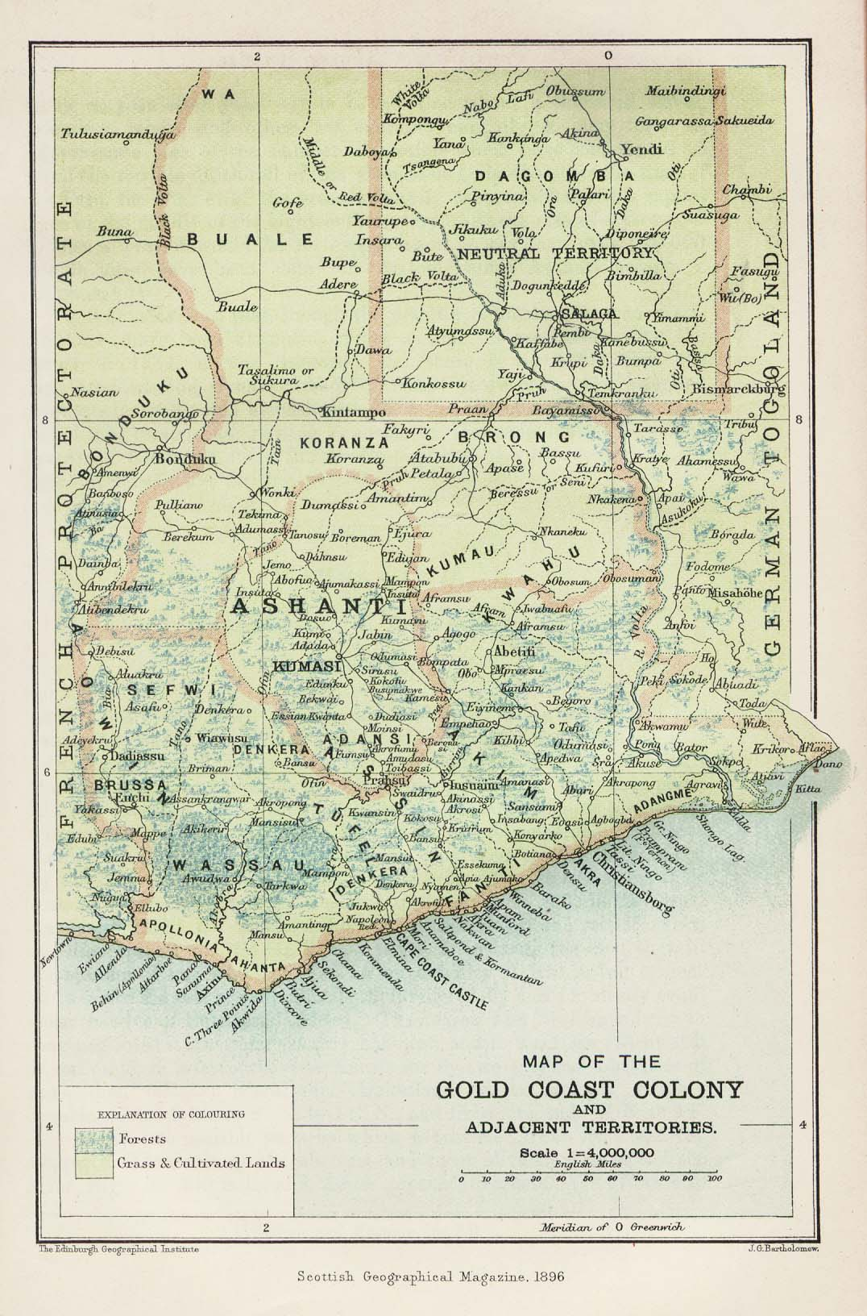
Context
Background research for Short Story Collection
  When The Black Star Rises
Independence day 6 Mar 1957
Oral histories from witnesses
About 5000 Europeans lived in The Gold Coast
75% were men
Less than 250 were children
  Almost all were schooled in Europe

Slide 4
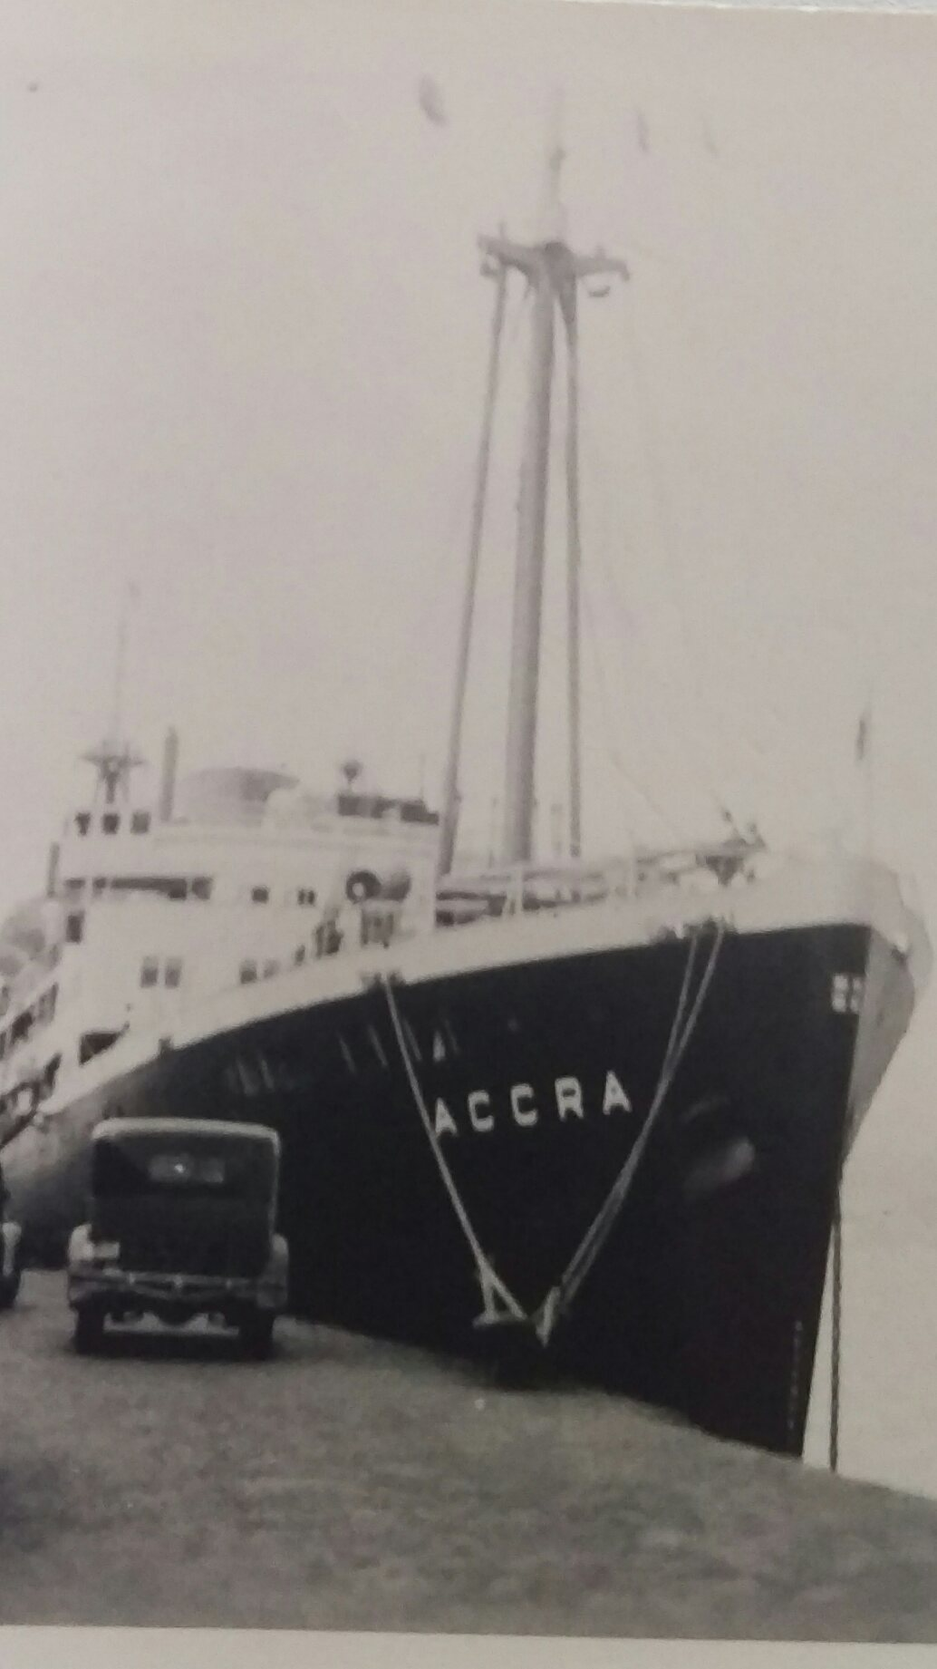
Going Home
Almost all interviewees prepared to leave
Fear based on rumors and comparisons
Families sent home
Loss of employment
Loss of status

Slide 5
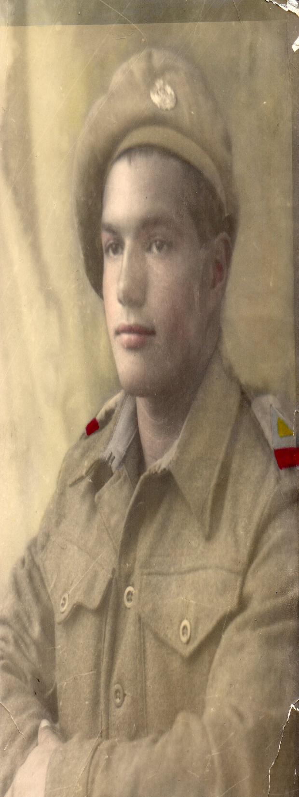
Moving
Military
Transnational Employees
NGO Staff
Overall least successful at reintegration

Slide 6
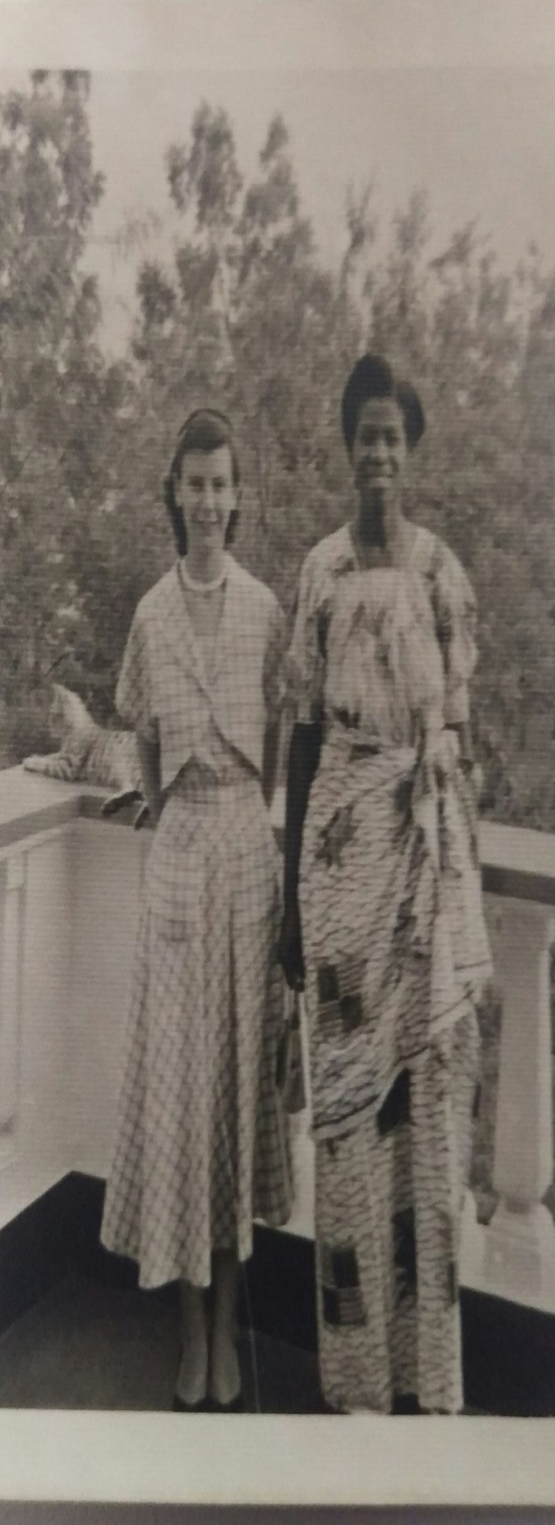
Staying
Incomplete contracts
Non-government employees
New contracts with new government
Missionaries who thought it their duty to stay

Slide 7
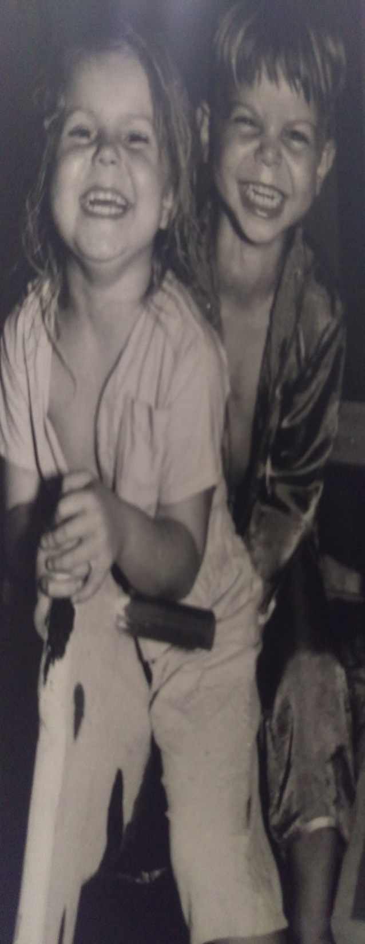
Families
Changing schools harder than changing countries
Non working wives lost social circle
Children settled quickly
Wives did not

Slide 8
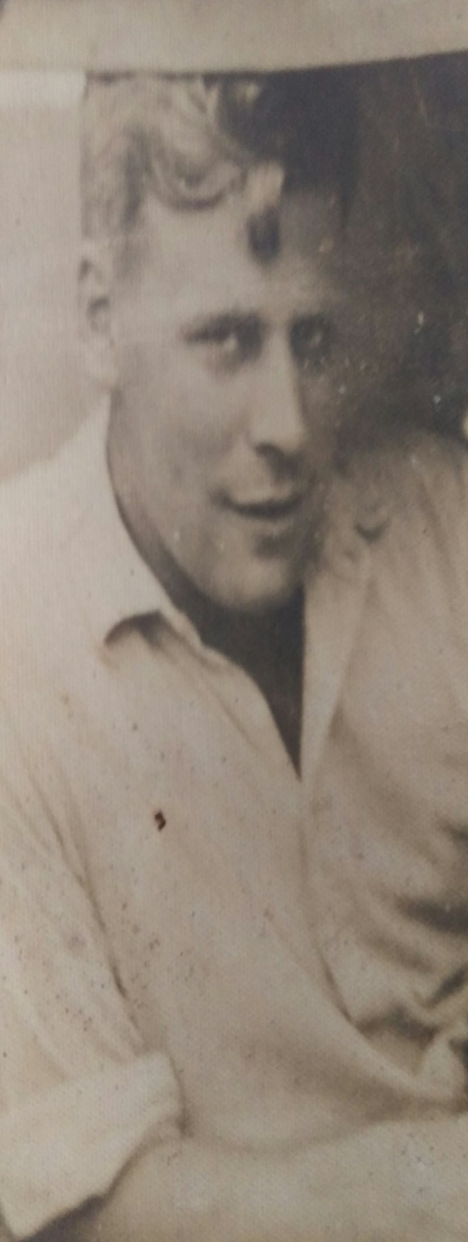
Summary
Successful reintegration depended on long term view of working in Africa
Employment in Europe was stratified and formal
The military and colonial officers found reintegration hardest
Social Circles networking was key to restelment
Most expatriates felt they could not talk about their experiences in Ghana

Slide 9
Contacts
bab1n15@soton.ac.uk
https://BlackStarStories.com

