Slide 1
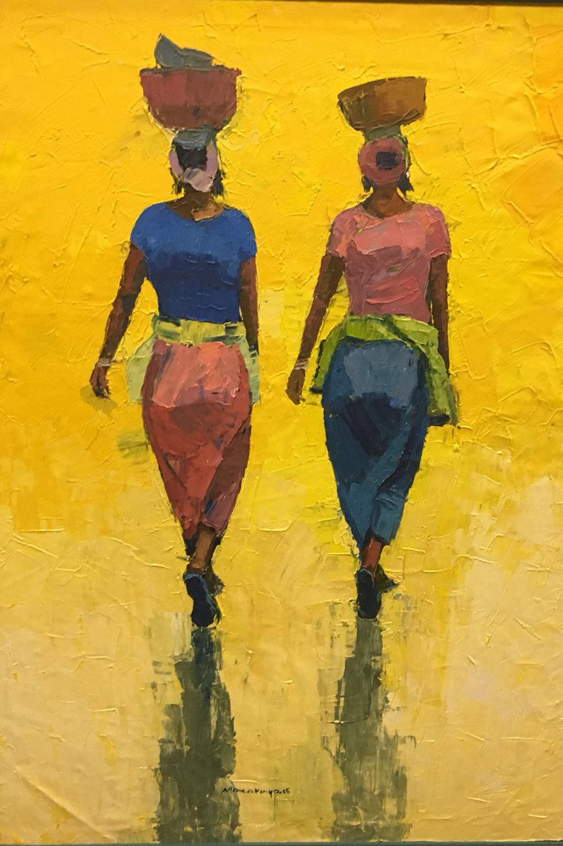
Crying When the Flag Came Down
A Preliminary Investigation into the Feelings of Displacement felt by European Expatriates Following Ghana’s Independence.
©Seye Morakinyo: Chuck Gallery, Manchester
Bridget Blankley
Notes:
I have a confession to make,
I’m a Creative Writing Student and to be honest,
although this sounds contradictory,
novelist aren’t used to telling the truth.
Unfortunately, in order to make our stories sound convincing,
even the laziest novelist has to undertake research.

Slide 2
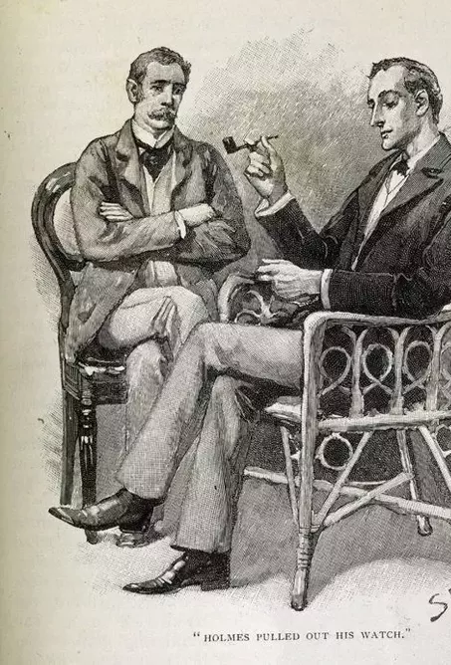
Contemporary Settings
“Just checking his Facebook status Watson.”
Notes:
The temptation to set novels in the past is strong,
Plotting is much easier
And you don’t have to worry about being out of date _ you already are
Just imagine the hound of the Baskervilles if
– Just imagine the Hound of the Baskervilles if Watson ran a quick online search on Stapleton and found his relationship status on Facebook was ‘it’s complicated’, (‘married to the woman I call my sister’ isn’t an option - I checked.)

Slide 3
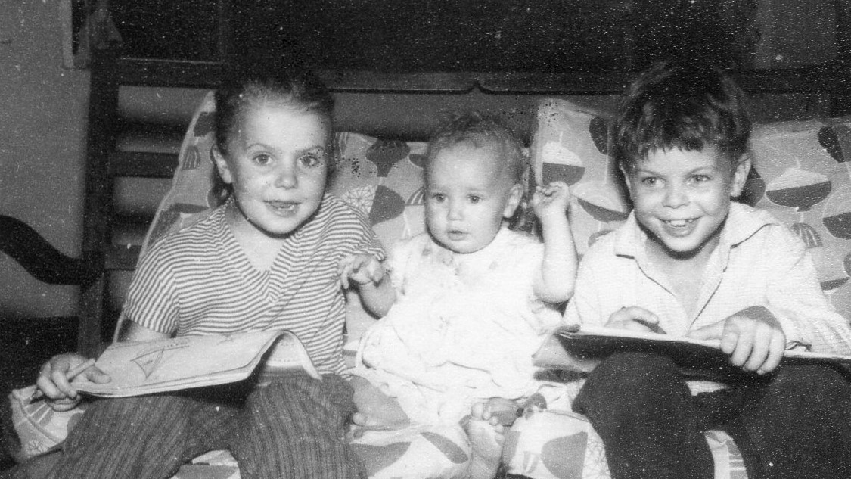
Write what you know?
Notes:
2nd reason write what you know
And I grew up in West Africa
My family attended the independence celebrations
Invitation of Osei Tutu Agyeman Prempeh II
So, I started to talk to relations, friends and friends of relations that were living in Accra in 1957,
and I got distracted.
I realised that many of them were deeply affected by the move back to Europe.
There was a strong sense of fear.
Fear of the unknown if they stayed in Ghana and
fear of not fitting if they returned to Europe.

Slide 4
8 Participants
2 couples, 2 widows, 2 single
4 British
1 Joint Nationality (British/South African)
3 Dutch
Notes:
Chosen because they were available
Not as representative
Surprisingly some apparent patterns

Slide 5
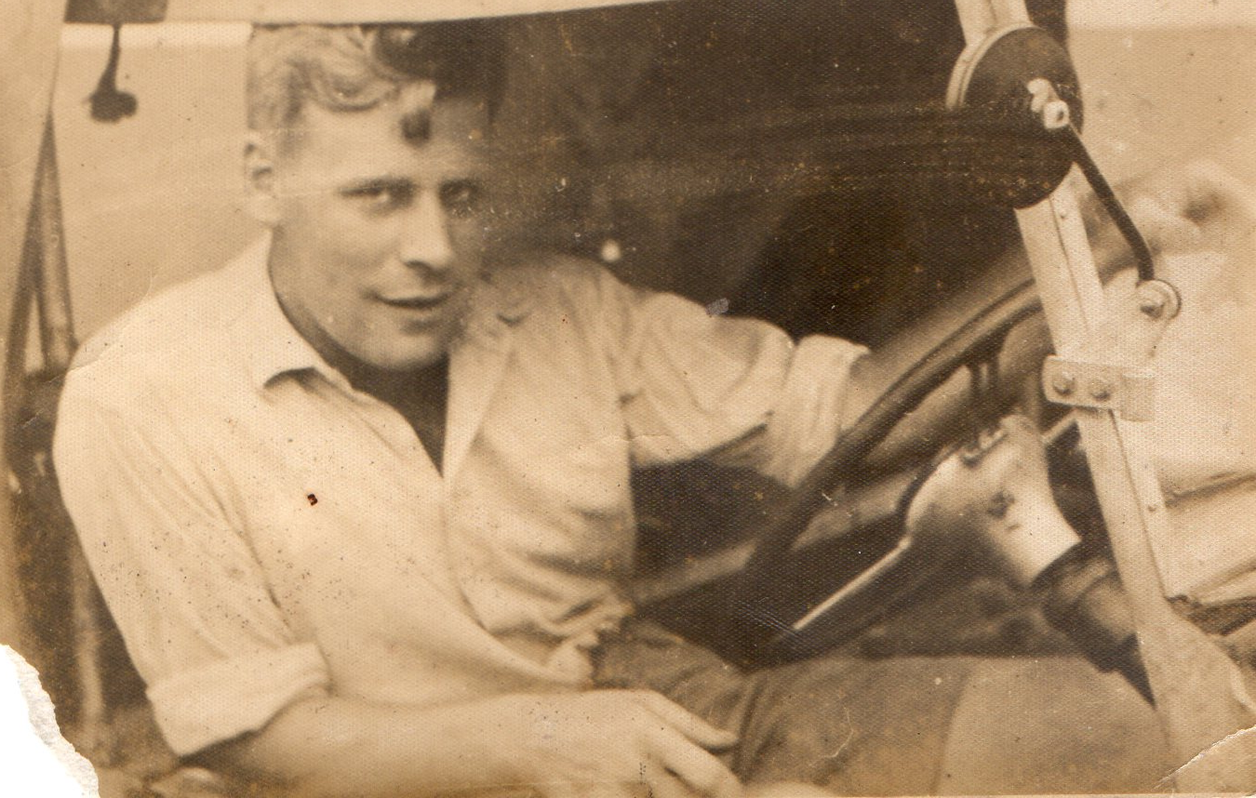
1) Men coped less well than women.
“Charlie couldn’t cope, he had a complete breakdown when we came home. That’s why we move to South Africa.” Jess
“Of course I was happy to come home, I didn’t marry a doctor to live like that. Harry wanted to stay, but I said no.” Emilie
“We stayed while we could, until African Woods moved out. We tried living in the UK but your Dad couldn’t stand it. He found a job in Nigeria and we stayed there.” Amy
Notes:
All of the men that I interviewed said that they had not expected to return to Europe,
at least not until they retired
Some of the women, like Emilie living in Ghana as a temporary event
Others, such as Amy and Isla, made their life in West Africa and felt that was their home.

Slide 6
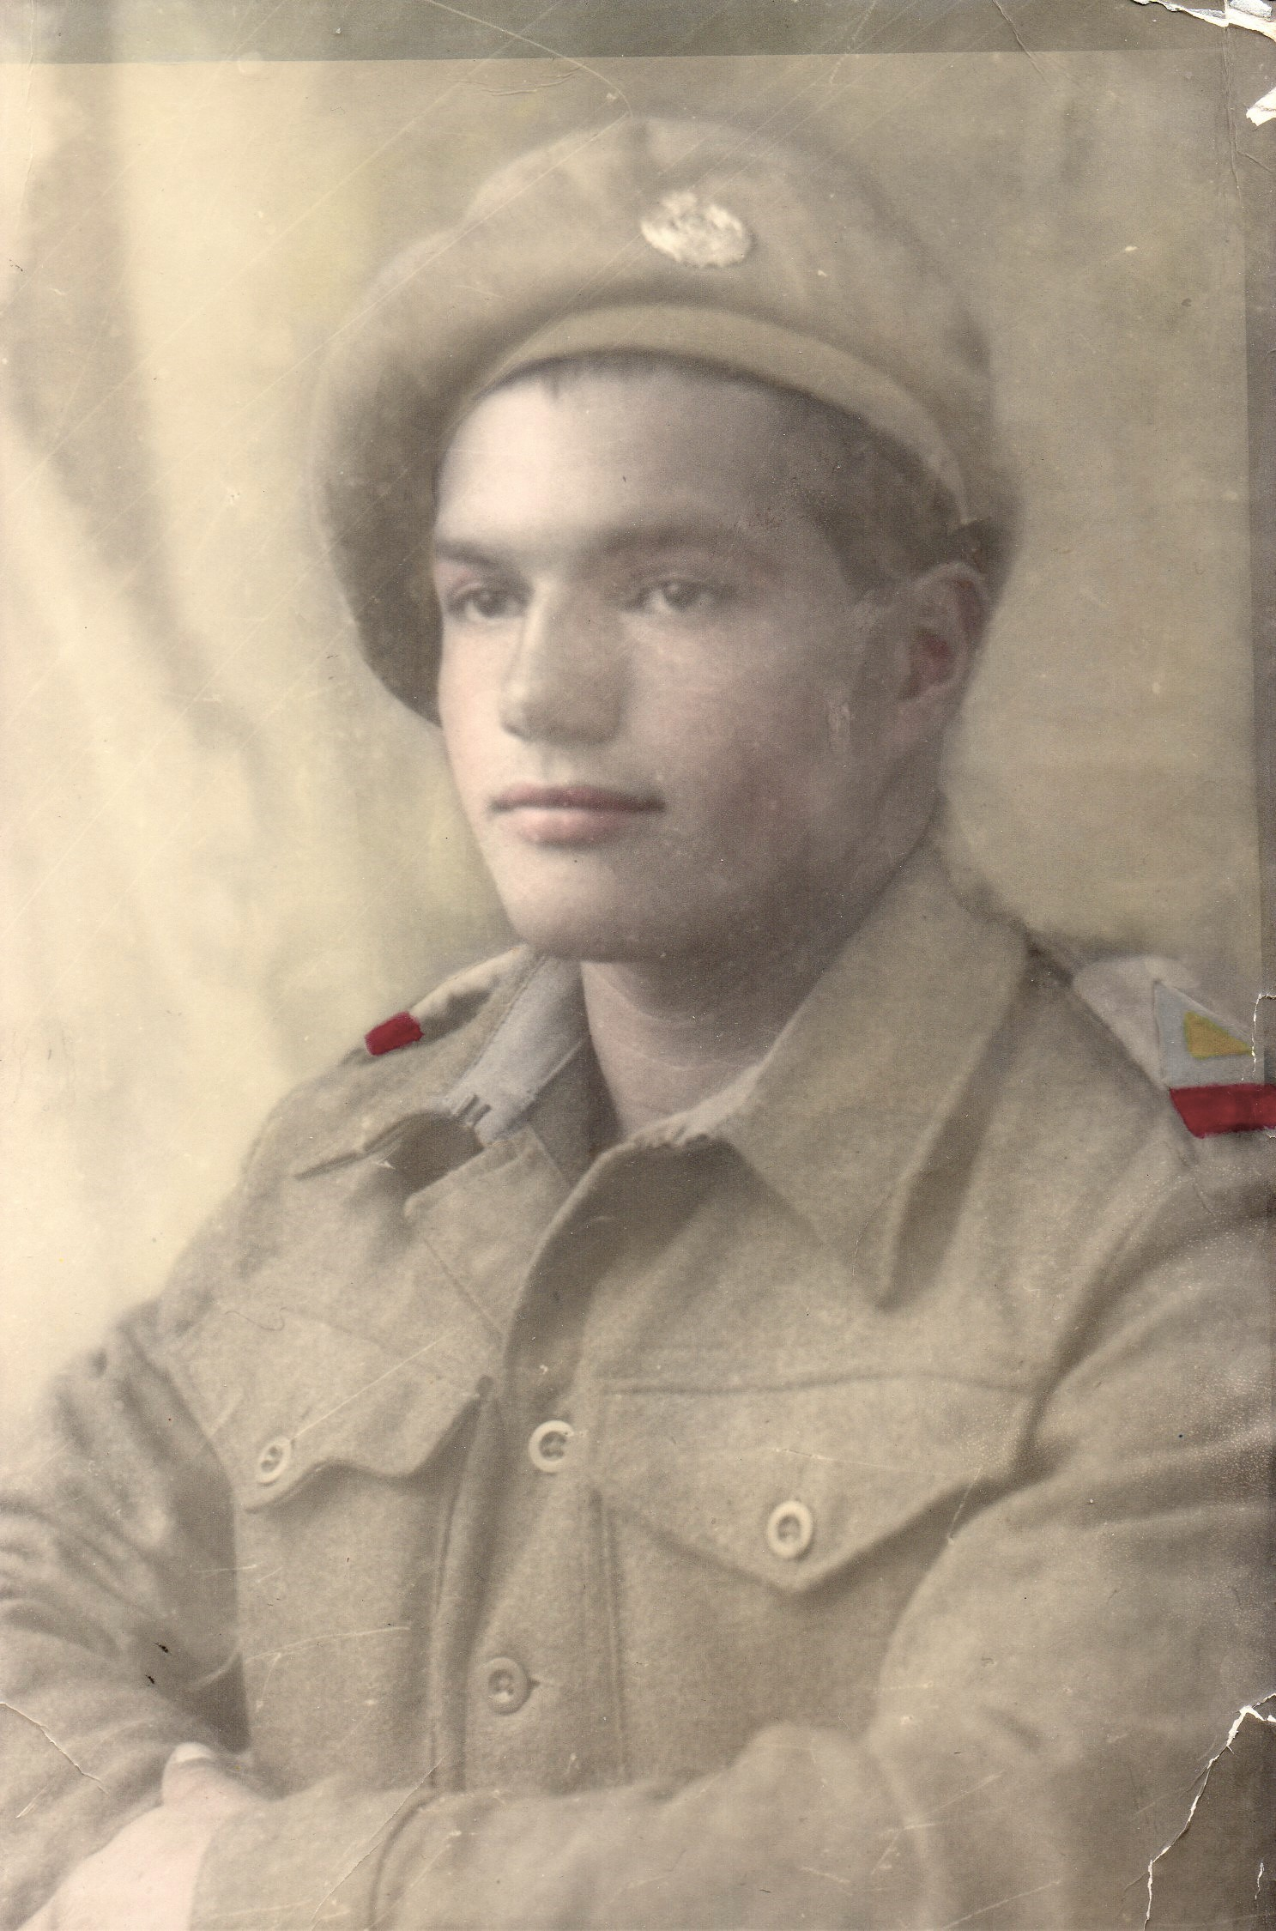
Officers of the Royal West African Frontier Force.
George and Charlie (not interviewed)
No military posts after independence
Both moved to South Africa
Happy in South Africa, both returned to UK in the 1990’s
Notes:
By interview with George and reported by Charlie’s wife, Jess
Neither wanted to have Ghanaian supervisors when they left the services
George joined South African army and remained in service for 20 yrs,
Stayed in south Africa, civilian, until he returned to UK to marry
Jess said Charlie had had enough of army and moved to South Africa to work as ship-wright
Stayed until majority rule.
Mixed messages about reasons for leaving.

Slide 7
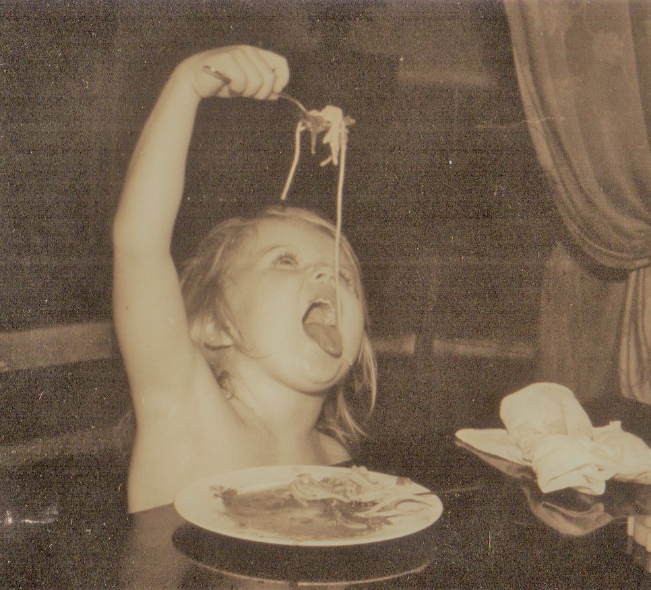
2) Less consistency from women.
For those who were married, home was where their family was.
2 women, Isla and Amy had children while they were in Ghana
1 Olive, a midwife said,
“Babies are babies, I cared for mothers and babies and I could do that anywhere. The mission brought us home, which was strange, but we soon got used to it. I delivered babies in Kumasi for 5 years, and in Heerlen for 40. That’s a lot of babies.”
Notes:
Sounds wrong by today’s standards but for women in the 50’s following your husband was the norm
Isla was brought home by the Methodist mission, but Jack found another mission who were still sending people out to northern Ghana and they returned living north of the Volta.
She returned in 1985 when Jack retired.

Slide 8
Summary
None of the men felt at home in Europe.
Most returned to Africa.
With the exception of Emilie, the wives followed their husbands
All participants said they felt at home in Ghana
There is not much time for further research.
Notes:
only the 3 Dutch participants remained in Europe until they retired
Even Emile said she felt at home, she just didn’t want it to be a permeant home
These expatriates are all in their 80s and 90s. 2 have died since I started the interviews, 2 have terminal cancer

Slide 9
Why the Title?
“When they brought down the Union Jack and raised the Ghanaian flag I cried. I thought who would expect a miner’s daughter to be here mixing with presidents and royalty. If I go home it will be back to my old life, living hand to mouth in a damp terrace. If I stay here will I still be welcome, will my children still be welcome? Where will we belong.”
Notes:
Quote from my mother when she was sorting out photographs.

Slide 10
and finally….
The Ghosts and Jamal
Pub Hope Road February 2018
Finding the Black Star
commissioned
publication expected 2019 /2020
Notes:
Please buy my books.

